Slide 1
SQL Injections

Slide 2
Before we start
If you haven’t installed Kali Linux yet please raise your hand

Slide 3
Before we start
Shame on you

Slide 4
Before we start
Just kidding, one of the demonstrator will come around to help you out with the installation
You DO NOT REQUIRE Kali Linux for today’s workshop
However we will use it in the future so please do install it in the near future

Slide 5
Practical Examples
We will run through these slides for only 15 minutes. The rest of the time will be working through the workshop guide

Slide 6
SQL?
Structured Query Language.
It is taught slightly in Database Systems. However their focus is to make you tech support.
SQL is the language of (relational) databases. We can use it to get information and can do various useful things with the data.
SQL looks like this:
SELECT * FROM `Users` WHERE `uname` = “foo”;

Slide 7
Database?
A database is a base with data.
Data can be important. For instance, with the previous example, this is a database “table” called “Users”:
uname | password | email
foo | password1 | test@email.com
bar | 1drowssap | another@example.com

Slide 8
How do we talk to these databases?
SQL! That’s the whole point.
But of course servers running a DBMS (database management system) such as MySQL or Oracle will not be publicly accessible:
There are permissions and users of database servers.
Authentication: you need to confirm who you are before you can connect to a database to perform transactions.
Authorisation: you cannot do things the DBMS says you cannot do.
Typically in the context of web applications, you can do “CRUD” on one database and its tables.
Create, Read, Update, Delete.

Slide 9
Where can this fail?
Direct connection
If people know the hostname and auth details of a MySQL server, they would be able to do anything with the database.
Only the web server should be talking to the database, perhaps through some API.
SQL Injection
Will get to this on the next slide. What happens if code is not treated differently to data?
Improper Permissions
If your web app fails at any point allowing access to one of the accounts used to access the database, they should only be able to do so much damage.

Slide 10
Code vs Data
Searching for data is absolutely fine. But what if the app thinks our data is actually code? How does it tell the difference?
Answer: it can’t. Not without some consideration.
The red writing is our SQL injection that always goes to true. This gives us all emails on the Users table.
SELECT `email` FROM `Users` WHERE `uname` = ‘’ or ‘1’=’1’;

Slide 11
SQL Injections
Let’s presume the cyber security team at Google is completely incompetent and do not sanitize their user inputs.
Only allowing the user to input data of your expected type. If it's not the proper type, discard it.

Slide 12
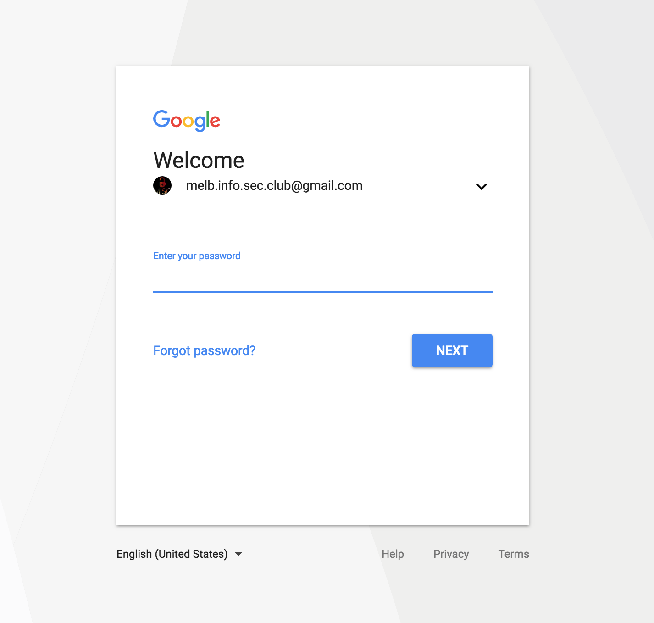

Slide 13
SQL Injections
So how can you trick the login?
Entering ' OR '1'='1 would give you access if user input is not sanitized
But why?

Slide 14
SQL Injections
SELECT `email` FROM `Users` WHERE `uname` = ‘’ or ‘1’=’1’;
The end quote escapes the query
What are other ways to escape queries? (Will be useful for worksheet)

Slide 15
Mitigation
Take backups. This is trivially easy for most DBMSs and should be done anyway.
Find necessary permissions for each user and only give those permissions.
Parameterise (prepared statements) and sanitise your inputs.
Or even easier, use a framework that does it for you.

Slide 16
Credits
Originally made by Thomas Wang
Updated by Tarnvir Grewal

Slide 17
On to the worksheet
git clone https://github.com/umisc/workshops.git
Or else go to https://github.com/umisc/workshops and download the repository
We will be using workshop_2 for today
We will go over them if people get stuck.
Feel free to roam around overthewire.

